Slide 1
AIRLINE PASSENGER SATISFACTION

Slide 2
Introduction
Airline Passengers’ individual ratings on different aspects of their journey is used to predict the overall passengers’ experience (Satisfied or Dissatisfied).
Technically, a Binary Classification!!!

Slide 3
Dataset
Features:
Predictor Column:
satisfaction
Columns | Columns
Row.Number | id
Gender | Customer.Type
Age | Type.of.Travel
Class | Flight.Distance
Inflight.wifi.service | Departure.Arrival.time.convenient
Ease.of.Online.booking | Gate.location
Food.and.drink | Online.boarding
Seat.comfort | Inflight.entertainment
On.board.service | Leg.room.service
Baggage.handling | Checkin.service
Inflight.service | Cleanliness
Departure.Delay.in.Minutes | Arrival.Delay.in.Minutes
Summary:
Rows: 103904
Cols: 25

Slide 4
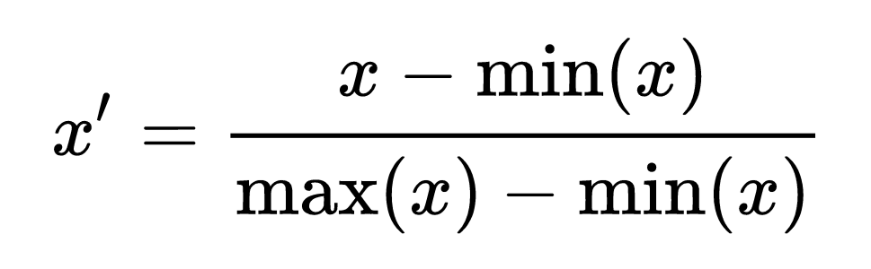
Preprocessing
Label Encoding
Normalization
NAs – No Need to Handle, WHY?!!!
Column Name | Value | Encoded Val
Gender | Male | 1
 | Female | 0
Customer.Type | Loyal Customer | 1
 | DisLoyal Customer | 0
Type.of.Travel | Business travel | 1
 | Personal travel | 0
Class | Business | 1
 | Eco | 0

Slide 5
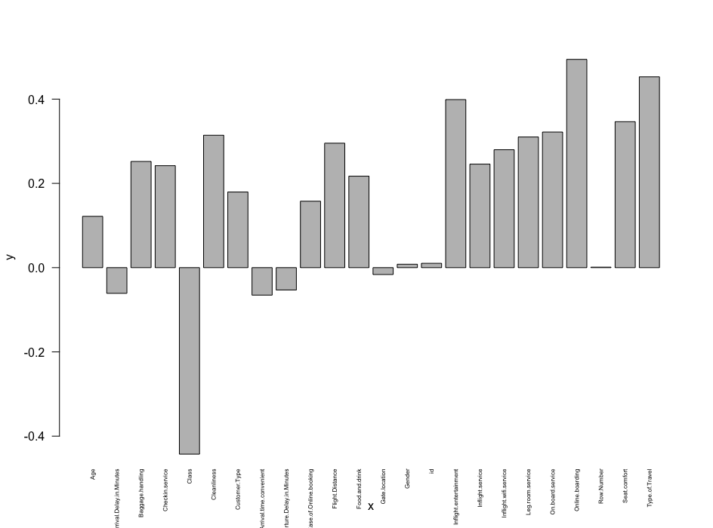
Exploratory Data Analysis
Intuition
Roll Number
ID
Correlation
Categorizing –
Age
Arrival.delay
Departure.delay

Slide 6
Models
Categorical Models
Random Forest
Naive Bayes
CART
KNN
Evaluation Factors
F1 Score
Precision
Recall
Accuracy

Slide 7
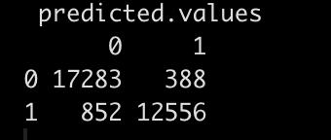
Random Forest

Slide 8
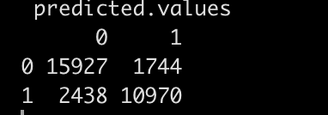
Naive Bayes

Slide 9
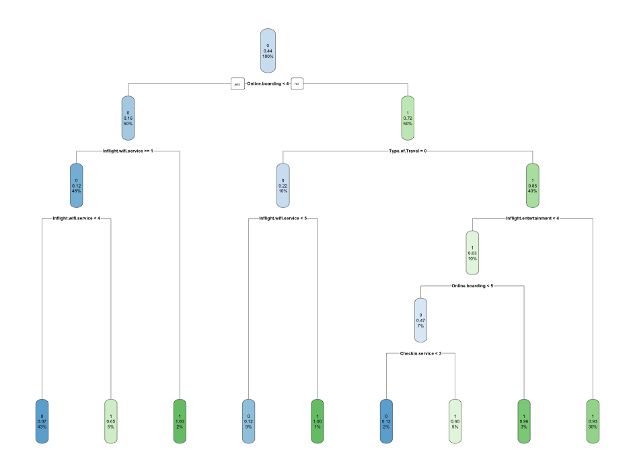
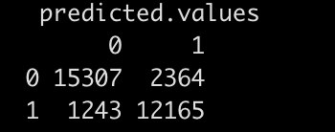
CART

Slide 10
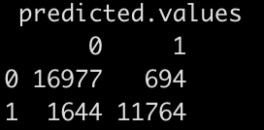
KNN

Slide 11
Comparison of Models
 | Accuracy | F1 Score
Naïve Bayes | 87 | 84
Random Forest | 96 | 95
CART | 88 | 87
KNN | 92 | 91

Slide 12
Conclusion
Based on the Customer’s Satisfaction on different aspects, any business can take the further decisions
Especially the areas need to be improved on priority. So, do the Airline Passenger Company.
Overall Satisfying Customer’s count would numerate the real improvement of the business.

